Slide 1

Challenging the Status Quo of Diversification:
An Analysis of Returns by Asset Class

Slide 2
THE CHALLENGE
Diversified
vs.
Bonds
ETF
Real Estate
Stocks
Cryptocurrency

Slide 3
TEST # 1
Monte Carlo Simulations
By Asset Class Portfolios
Historical data: Jan 1, 2018 – Nov 5, 2021
10 Year Forecast
1000 Simulation Analysis

Slide 4
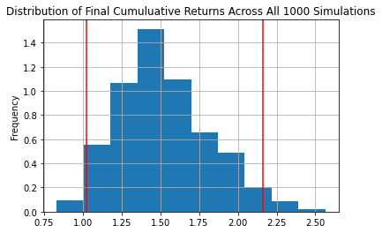
BONDS
• BLV • BND • EDV • VCLT • VGLT •
Monte Carlo Simulation 10 Years

Slide 5
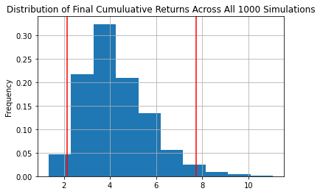
ETF
• EEM • VOO • VTI • VTV • VUG •
Monte Carlo Simulation 10 Years

Slide 6
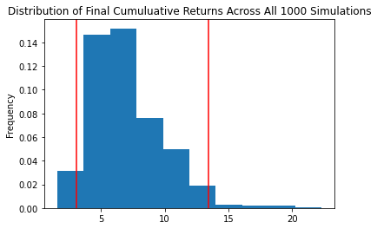
REAL ESTATE
• AMT • PLD • CCI • EQIX • PSA •
Monte Carlo Simulation 10 Years

Slide 7
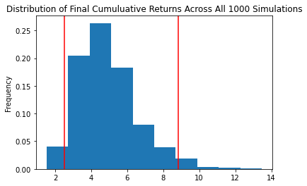
STOCKS
• FB • AMZN • AAPL • XOM • JPM •
• JNJ • HON • LIN • AMT • PG • NEE •
Monte Carlo Simulation 10 Years

Slide 8
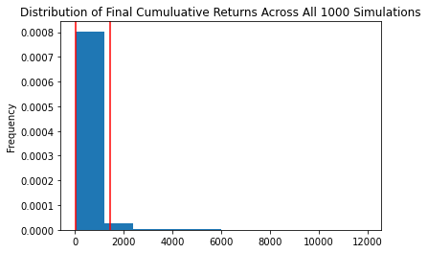
CRYPTO
• BTC • ETH • BNB • DASH • LTC •
Monte Carlo Simulation 10 Years

Slide 9
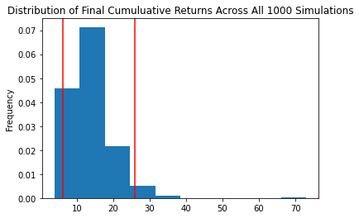
DIVERSIFIED
• VOO • MSFT • AAPL • BND • AMT •
• VUG • TSLA • AMZN • EDV • PLD •
Monte Carlo Simulation 10 Years

Slide 10
MONTE CARLO ANALYSES QUANTIFIED
What are the expected returns?
95% confidence level
Initial investment of $10k
*input CI intervals here

Slide 11
TEST # 2
Historical Returns Comparison
Average Annualized Returns
Cumulative Returns

Slide 12
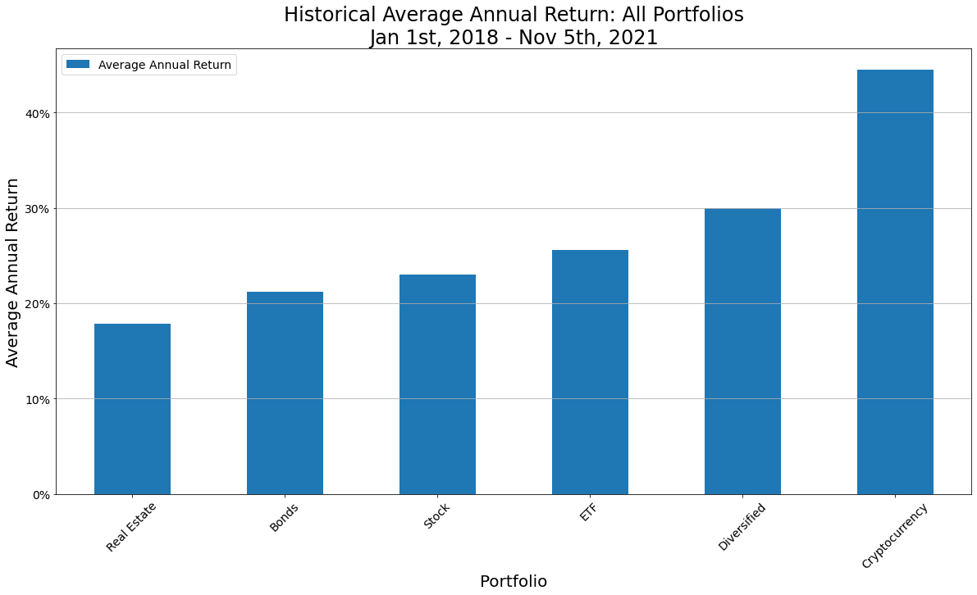
ANNUALIZED RETURNS
• Comparison Across Portfolios •

Slide 13
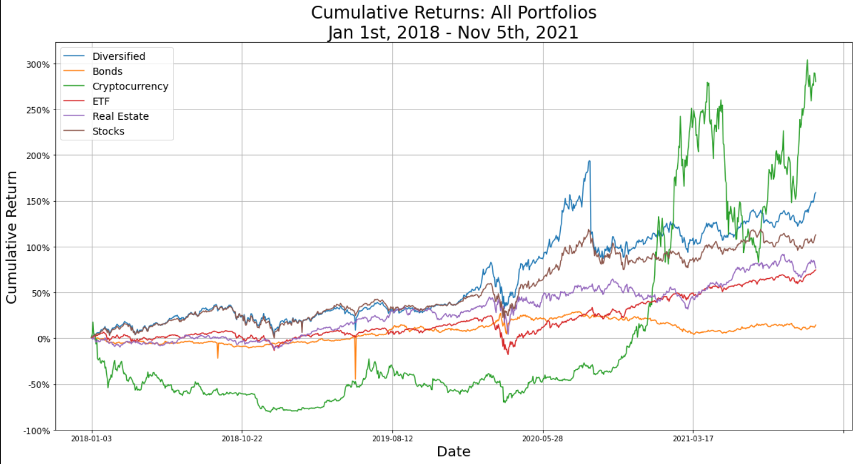
CUMULATIVE RETURNS
• Comparison Across Portfolios •

Slide 14
TEST # 3
Sharpe Ratios
What is the risk-adjusted return?

Slide 15
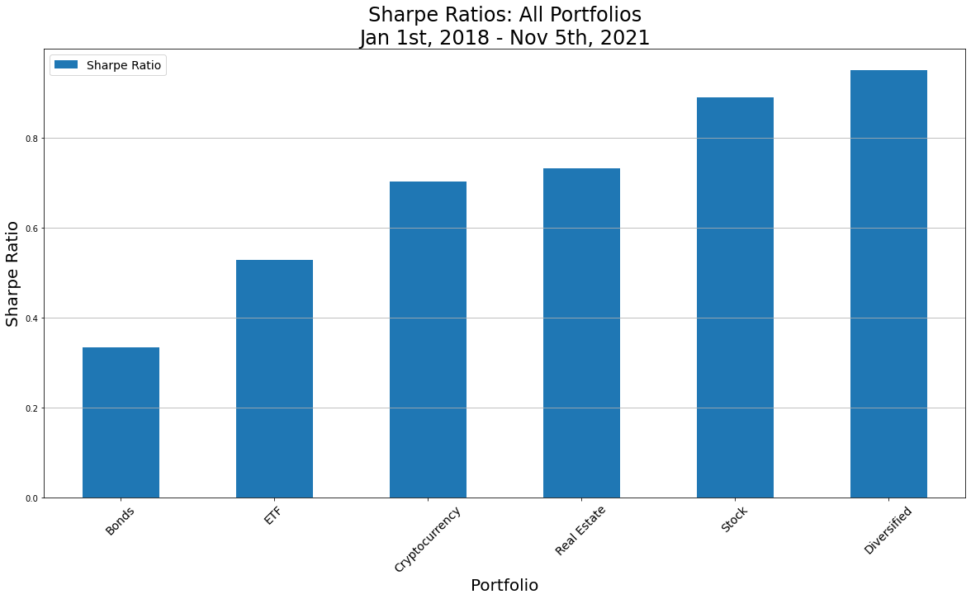
SHARPE RATIO
• Comparison Across Portfolios •
 | Bonds | ETF | Crypto | Real Est | Stock | Diversified
Annual Avg Return | 21.23% | 25.61% | 44.49% | 17.82% | 23.00% | 29.95%
Annual Std Dev | 63.58% | 48.54% | 63.38% | 24.33% | 25.87% | 31.53%

Slide 16
Two column bullet points
Bullets go in here
And also in here

Slide 17
Example of a table
Title | Title
Data | Data
Note: PowerPoint does not allow have nice default tables – but you can cut and paste this one

Slide 18
Sample Graph (3 colours)
 | Bonds | ETF | Crypto | Real Est | Stock | Diversified
Annual Avg Return | 21.23% | 25.61% | 44.49% | 17.82% | 23.00% | 29.95%
Annual Std Dev | 63.58% | 48.54% | 63.38% | 24.33% | 25.87% | 31.53%

Slide 19
Example of a chart (4 colours)

Slide 20
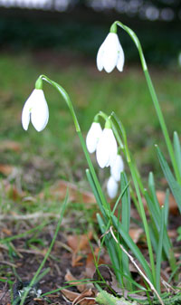
Picture slide
Bullet 1
Bullet 2

Slide 21
Examples of default styles
Text and lines are like this
Hyperlinks like this
Visited hyperlinks like this
Table
Text box
Text box
With shadow

Slide 22
Use of templates
You are free to use these templates for your personal and business presentations.
We have put a lot of work into developing all these templates and retain the copyright in them. They are not Open Source templates. You can use them freely providing that you do not redistribute or sell them.
Do
Use these templates for your presentations
Display your presentation on a web site provided that it is not for the purpose of downloading the template.
If you like these templates, we would always appreciate a link back to our website. Many thanks.
Don’t
Resell or distribute these templates
Put these templates on a website for download. This includes uploading them onto file sharing networks like Slideshare, Myspace, Facebook, bit torrent etc
Pass off any of our created content as your own work
You can find many more free templates on the Presentation Magazine website www.presentationmagazine.com

